Slide 1
Student Performance Indicator
Using Python and Machine Learning
Presented by-
Ankit Maurya
Roll no.-10
MCA 3th Sem

Slide 2
Abstract: STUDENT PERFORMANCE INDICATOR (SPI) deals with the maintenance of university, college, faculty, student information within the university. SPI is an automation system, which is used to store the college, faculty, student, courses and information of a college .Starting from registration of a new student in the college , it maintains all the details regarding the attendance and marks of the students. The project deals with retrieval of information through an INTRANET based campus wide portal. It collects related information from all the departments of an organization and maintains files, which are used to generate reports in various forms to measure individual and overall performance of the students. Development process of the system starts with System analysis. System analysis involves creating a formal model of the problem to be solved by understanding requirements

Slide 3
Introduction
A coursework submission and grading system plays a key role in a course management system at a university. But, such systems don't often relate expectations, outcomes and performance. As each student desires to achieve a good score for each assignment, exam, and/or technical report, the whole process adds heavy workload for instructors in order to make their evaluation fair, comprehensive, and accurate. From the faculty perspective, these are necessary to avoid disagreement from students. An online grading system is a highly desirable addition to the educational tool-kit, particularly when it can provide less effort and a more effective outcome.

Slide 4
1. Problem Statement
The problem statement can be defined as follows ”Given a dataset containing attribute of 395 Portuguese students where using the features available from dataset and define classification algorithms to identify whether the student performs good in final grade exam, also to evaluate different machine learning models on the dataset.”

Slide 5
Description of the Dataset
This data approach student achievement of two Institute. The data attributes include student grades, demographic, social and school-related features) and it was collected by using school reports and questionnaires. Two datasets are provided regarding the performance in two distinct subjects: Mathematics (mat) and English language (eng). In the two data sets were modeled under binary/five-level classification and regression tasks. Important note: the target attribute G3 has a strong correlation with attributes G2 and G1.
This occurs because G3 is the final year grade (issued at the 3rd period), while G1 and G2 correspond to the 1st and 2nd period grades. It is more difficult to predict G3 without G2 and G1, but such prediction is much more useful (see paper source for more details).

Slide 6
Attribute Information:
school - student's school (binary: 'IPS' – Institute of profressional Studies or 'UIM' – United Institute of Management)
sex - student's sex (binary: 'F' - female or 'M' - male)
age - student's age (numeric: from 15 to 22)
address - student's home address type (binary: 'U' - urban or 'R' - rural)
famsize - family size (binary: 'LE3' - less or equal to 3 or 'GT3' - greater than 3)
Pstatus - parent's cohabitation status (binary: 'T' - living together or 'A' - apart)
Medu - mother's education (numeric: 0 - none, 1 - primary education (4th grade), 2 - “ 5th to 9th grade, 3 - “ secondary education or 4 - “ higher education)
Fedu - father's education (numeric: 0 - none, 1 - primary education (4th grade), 2 - “ 5th to 9th grade, 3 - “ secondary education or 4 - “ higher education)
Mjob - mother's job (nominal: 'teacher', 'health' care related, civil 'services' (e.g. administrative or police), 'at_home' or 'other')
Fjob - father's job (nominal: 'teacher', 'health' care related, civil 'services' (e.g. administrative or police), 'at_home' or 'other')
reason - reason to choose this school (nominal: close to 'home', school 'reputation', 'course' preference or 'other')

Slide 7
guardian - student's guardian (nominal: 'mother', 'father' or 'other')
traveltime - home to school travel time (numeric: 1 - <15 min., 2 - 15 to 30 min., 3 - 30 min. to 1 hour, or 4 - >1 hour)
studytime - weekly study time (numeric: 1 - <2 hours, 2 - 2 to 5 hours, 3 - 5 to 10 hours, or 4 - >10 hours)
failures - number of past class failures (numeric: n if 1<=n<3, else 4)
schoolsup - extra educational support (binary: yes or no)
famsup - family educational support (binary: yes or no)
paid - extra paid classes within the course subject (Math or Portuguese) (binary: yes or no)
activities - extra-curricular activities (binary: yes or no)
nursery - attended nursery school (binary: yes or no)
higher - wants to take higher education (binary: yes or no)
internet - Internet access at home (binary: yes or no)

Slide 8
famrel - quality of family relationships (numeric: from 1 - very bad to 5 - excellent)
freetime - free time after school (numeric: from 1 - very low to 5 - very high)
goout - going out with friends (numeric: from 1 - very low to 5 - very high)
health - current health status (numeric: from 1 - very bad to 5 - very good)
absences - number of school absences (numeric: from 0 to 93)

Slide 9
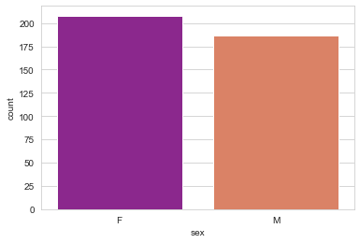
Count Plot for Student Sex Attribute

Slide 10
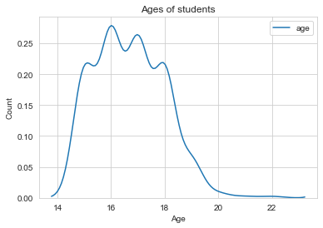
Kernel Density Estimation for Age of Students.

Slide 11
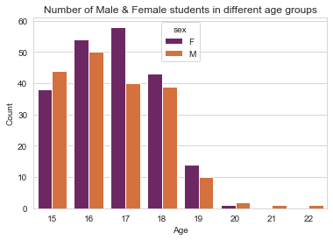
Count Plot for Male & Female students in different age groups.

Slide 12
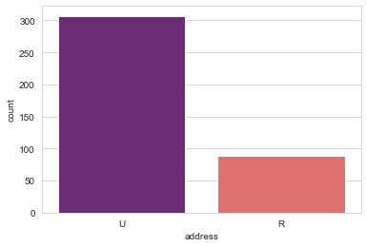
Count Plot for students from Urban & Rural Region

Slide 13
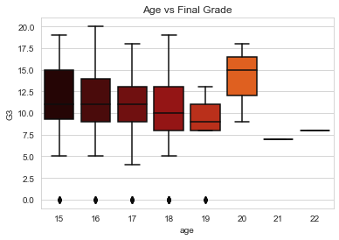
Does age affect final grade

Slide 14
Observation:
Plotting the distribution rather than statistics would help us better understand the data.
The above plot shows that the median grades of the three age groups(15,16,17) are similar. Note the skewness of age group 19. (may be due to sample size). Age group 20 seems to score highest grades among all.

Slide 15
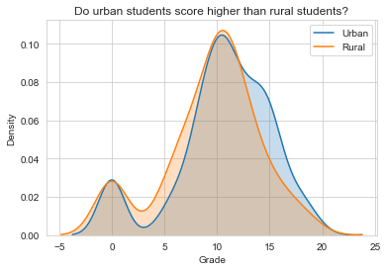
Do urban students perform better than rural students?

Slide 16
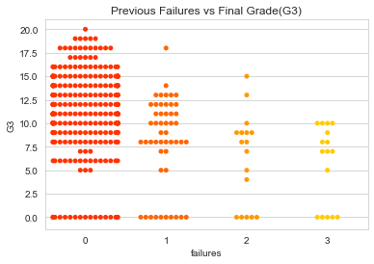
Previous Failures vs Final Grade(G3)

Slide 17
Observation: Student with less previous failures usually score higher

Slide 18
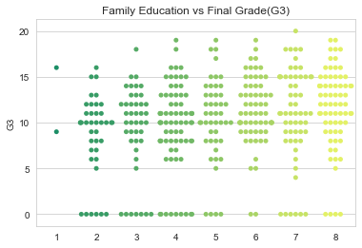
Observation: Educated families result in higher grades

Slide 19
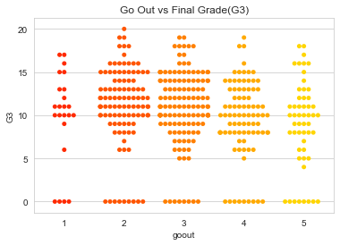
Observation: The students have an average score when it comes to going out with friends & Students who go out a lot score less

Slide 20
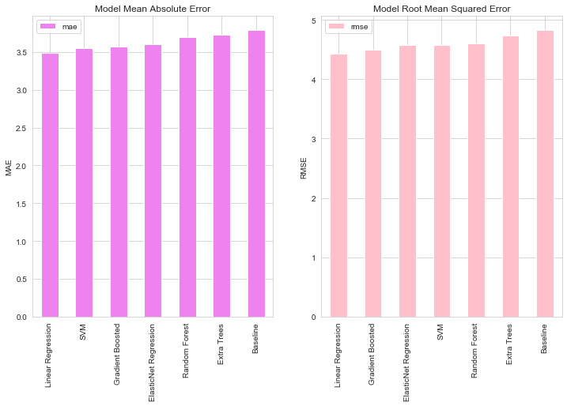
Conclusion As we see both MAE & Model RMSE that the Linear Regression is performing the best in both cases.

